Slide 1
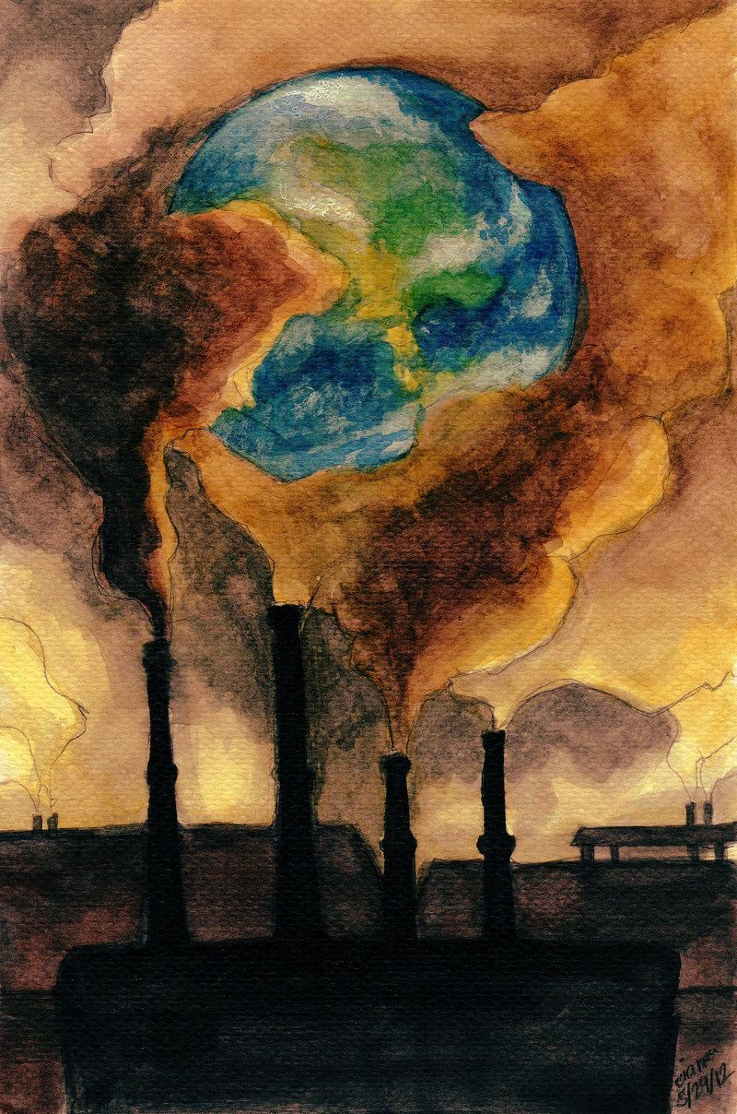
Sri Sai Ram Institute of Technology
Tech Destroyers
Team members
1.S.Hariharan
2.Shailesh Muruga
3.Mohammed Ibrahim
4.Pavithra

Slide 2
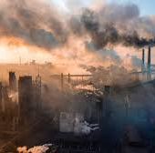
Controlling Air pollution in factories Using AQI & Alerting pollution control board With Warning messages

Slide 3
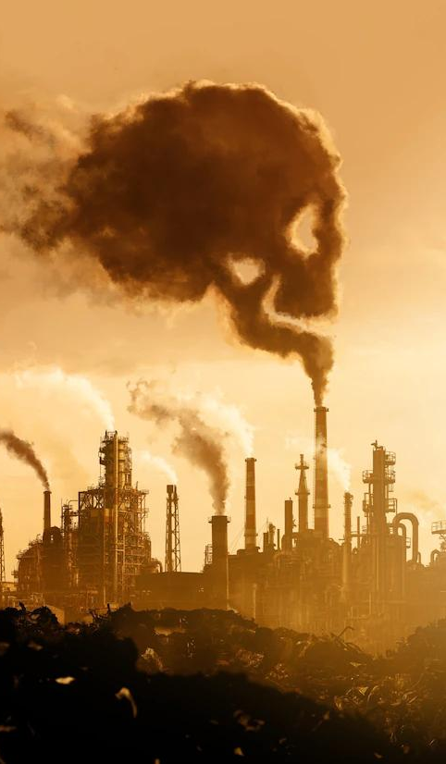
Abstract
Air pollution in industrial settings is a pressing concern, demanding effective control mechanisms to safeguard both human health and the environment. This study proposes a comprehensive approach to mitigate air pollution within factories through the implementation of an Air Quality Index (AQI)-based alert system. The research involves real-time monitoring of multiple pollutants, including particulate matter (PM2.5 and PM10), volatile organic compounds (VOCs), sulfur dioxide (SO2), nitrogen dioxide (NO2), and carbon monoxide (CO). The collected data is processed to calculate the AQI, providing a clear and comprehensible assessment of air quality. When AQI levels surpass predefined thresholds, an intelligent alert system is triggered to notify the pollution control board promptly. Warning messages are dispatched to the relevant authorities, enabling them to take timely actions such as inspections, issuing fines, or implementing corrective measures on the factory premises.

Slide 4

Problem statement
Develop an effective and sustainable solution for controlling air pollution in factories, aiming to reduce emissions of harmful pollutants, improve air quality in surrounding areas, and ensure compliance with environmental regulations while minimizing operational disruptions and economic impact on the factory.

Slide 5
Air Pollution In Factories
Air pollution from factories is a significant environmental concern, characterized by the release of harmful pollutants such as particulate matter, greenhouse gases, nitrogen oxides, sulfur dioxide, volatile organic compounds, and hazardous substances. These emissions can lead to a range of adverse effects, including respiratory problems, climate change, acid rain, and damage to ecosystems. Governments and regulatory bodies worldwide strive to impose emissions limits and promote cleaner production technologies to mitigate these impacts and safeguard public health and the environment. Reducing factory air pollution remains a critical goal for a sustainable and healthier future.

Slide 6
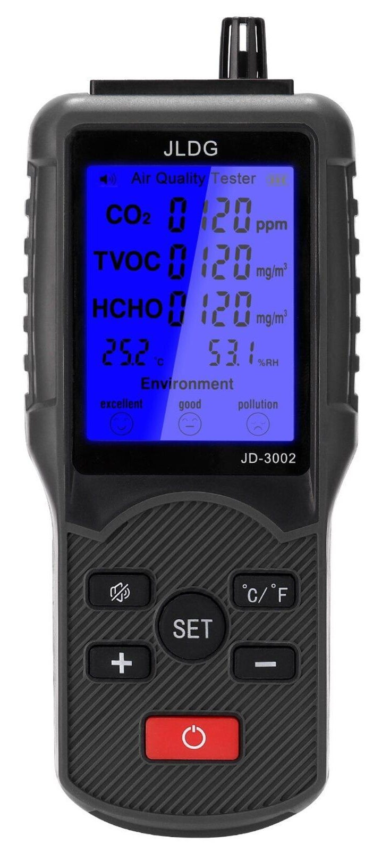
About Air Quality Index (AQI)
The Air Quality Index (AQI) is a standardized system used to assess and communicate the quality of the air in a specific location. It quantifies the concentration of various air pollutants, such as particulate matter (PM2.5 and PM10), ground-level ozone (O3), nitrogen dioxide (NO2), sulfur dioxide (SO2), and carbon monoxide (CO), into a single numerical value. This index typically ranges from 0 to 500 or even higher, with lower values indicating better air quality. AQI values are divided into categories, ranging from "Good" to "Hazardous," helping the public and policymakers understand the potential health risks associated with current air conditions and take appropriate measures to protect public health, especially for sensitive groups like children, the elderly, and those with preexisting respiratory conditions.

Slide 7
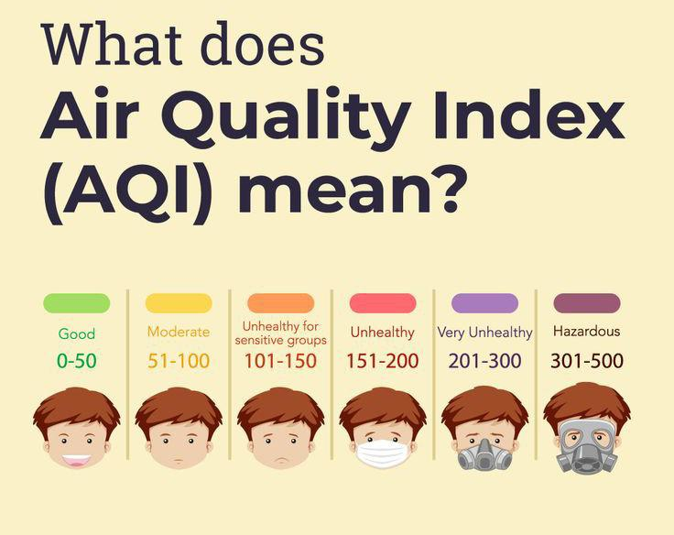
Green: Good (0-50): Air quality is satisfactory, and there is little or no risk to public health.
Yellow: Moderate (51-100): Air quality is acceptable; however, there may be a slight concern for some individuals who are unusually sensitive to air pollution
Orange: Unhealthy for Sensitive Groups (101-150): Members of sensitive groups, such as children, the elderly, and individuals with respiratory or heart conditions, may experience health effects. The general public is less likely to be affected.
Red: Unhealthy (151-200): Everyone may start to experience health effects, and members of sensitive groups may experience more serious effects
Purple: Very Unhealthy (201-300): Health alert – everyone may experience more serious health effects
Maroon/Brown: Hazardous (301-500): Health warning of emergency conditions. The entire population is more likely to be affected.

Slide 8
1.Sensor Deployment:
Factories install air quality sensors at strategic locations to measure various pollutants, such as particulate matter (PM), gases (like NO2, SO2, CO), and ozone (O3). These sensors continuously collect data on pollutant concentrations.
2.Data Collection:
Sensors collect real-time air quality data and transmit it to a central monitoring system. This data includes pollutant concentrations and environmental conditions like temperature and humidity.
3 Data Validation:
The collected data undergoes validation and quality control checks to identify and correct any anomalies or errors. This step ensures the accuracy of the information
4.Data Processing:
Processed data is used to calculate the AQI values for each pollutant based on established formulas and standards. These values are typically updated hourly or more frequently.

Slide 9
5.AQI Calculation:
Once individual pollutant AQI values are determined, the highest value among them is used to determine the overall AQI for that location.
7.Threshold Comparison:
The AQI value is compared to predefined threshold levels or breakpoints, which correspond to the AQI color code categories (e.g., Good, Moderate, Unhealthy). Alarm thresholds are set based on these categories.
6.Alarm Systems:
Alarm systems are triggered when the AQI exceeds predetermined thresholds. These alarms can be visual (e.g., warning lights), auditory (e.g., sirens), or communicated electronically to alert factory personnel and relevant authorities
8.Notifications and Responses: When alarms are triggered, the appropriate personnel are notified. Factory management can then response protocols, which may include adjusting production processes, evacuating sensitive individuals, or taking other measures to mitigate air quality issues.

Slide 10
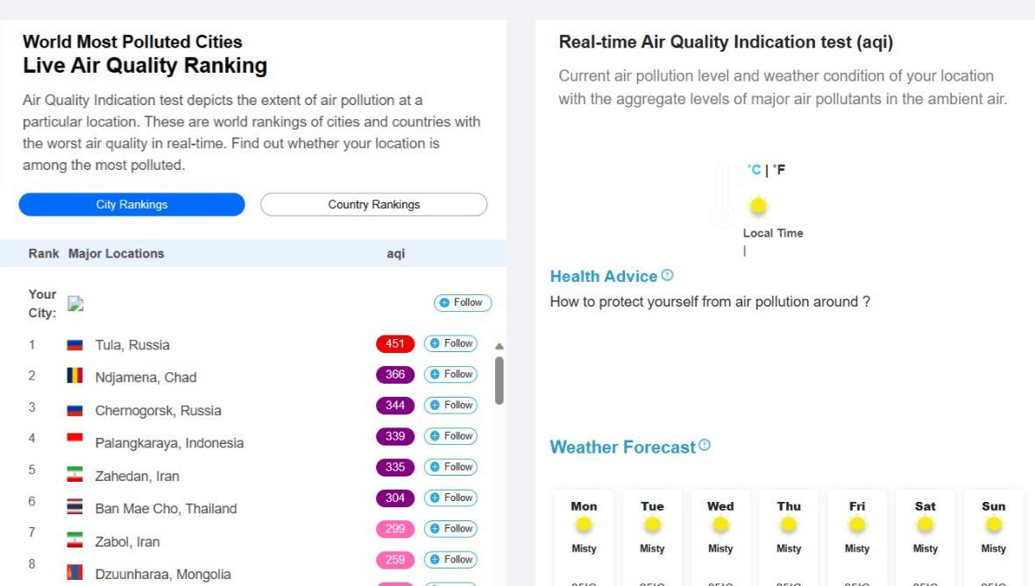
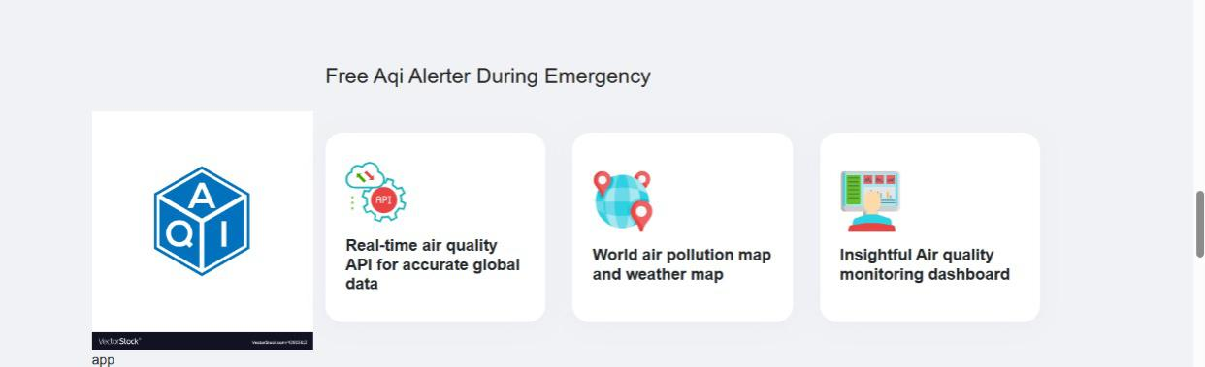
W
E
B
S
I
T
E

Slide 11
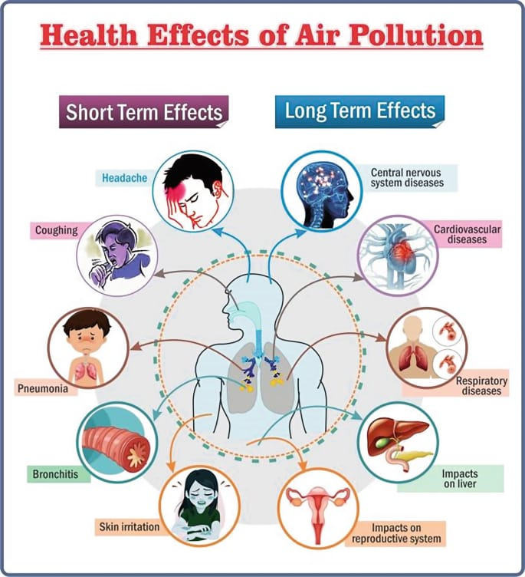

Slide 12
REFERENCES
** "Air Quality Index (AQI) Basics" - United States Environmental Protection Agency (EPA)
**"Air Pollution Control in Factories" - Environmental Protection Agency (EPA) Guidelines
**"Smart Factory Air Quality Monitoring System" - Research Paper on Environmental Monitoring Systems
** "Real-time Air Quality Monitoring and Alert System" - Case Study on Implementing AQI Alerts in Industrial Settings

Slide 13


